Slide 1
FOREST FIRE
DETECTION

Slide 2
INTRODUCTION
Forest fires can cause damage to natural resources, property and human life.
There can be different causes of forest fires including lightening, human negligence, volcanic eruptions and sparks from rock falls.
Early detection of forest fires can help in minimizing the damage.
This can be done by detecting smoke and temperature using the MQ135 Sensor and DHT11 Sensor

Slide 3
Components Used: ESP 32 Wifi Module, DHT11 Sensor, MQ135 Sensor, LED
Software: Arduino IDE
Language Used: Embedded C
DataBase: Firebase, ThingSpeak
App FrameWork: Blynk App, MIT Inventor App, Streamlit WebApp

Slide 4
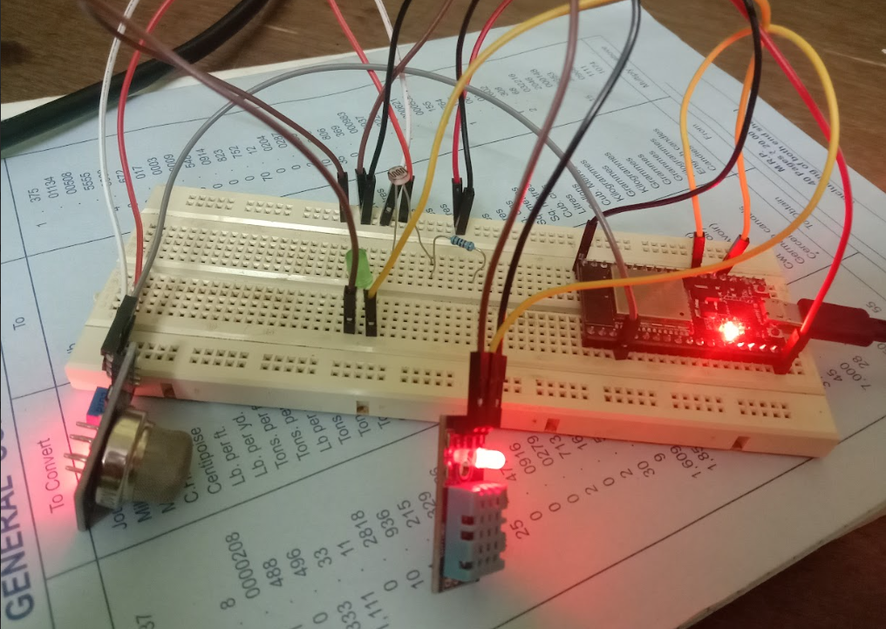
Hardware

Slide 5
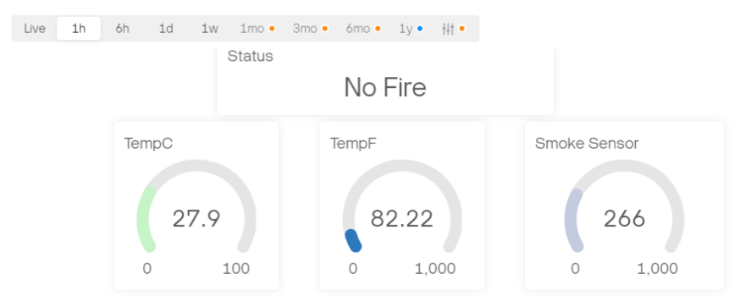
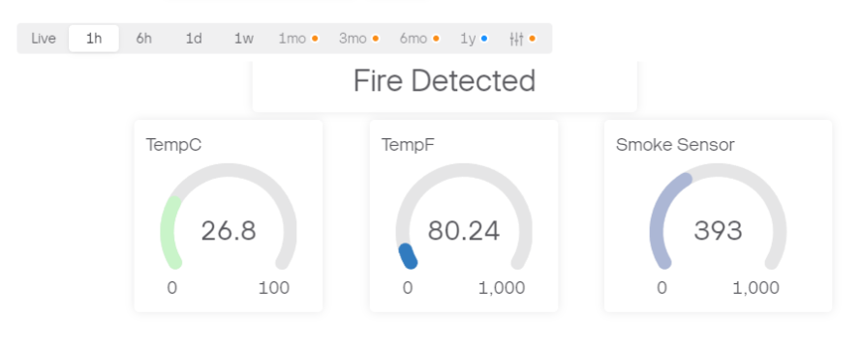
Blynk Dashboard

Slide 6
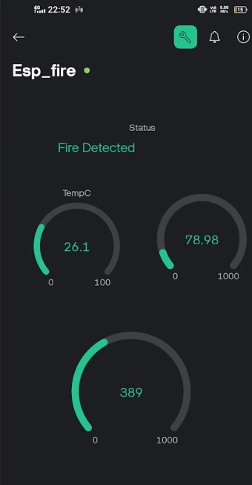
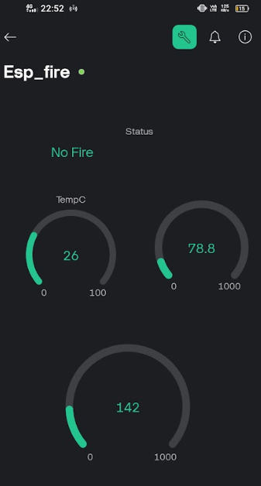
Blynk App

Slide 7
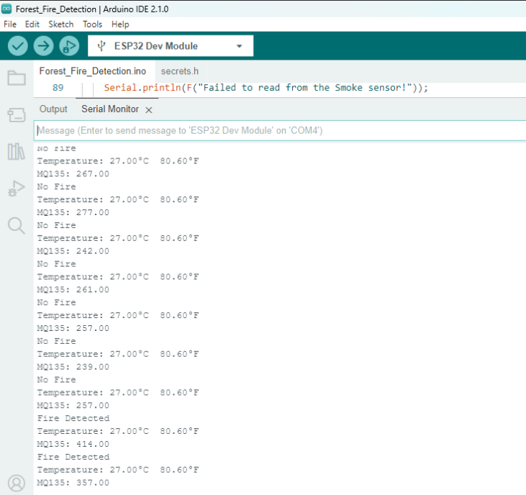
Arduino IDE

Slide 8
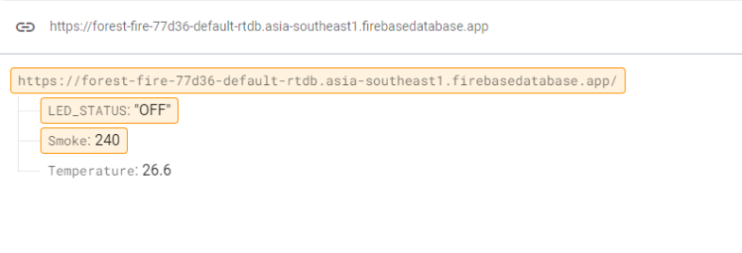
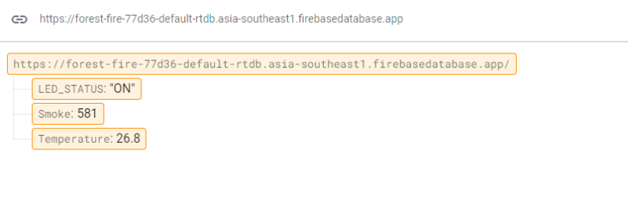
Firebase Database

Slide 9
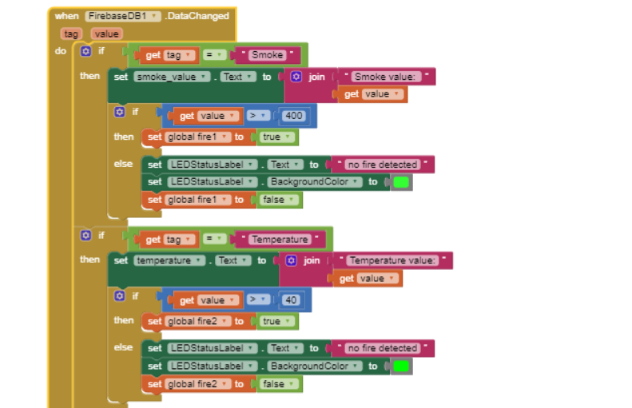
MIT INVENTOR APP

Slide 10
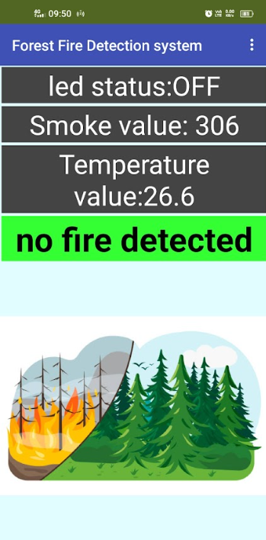
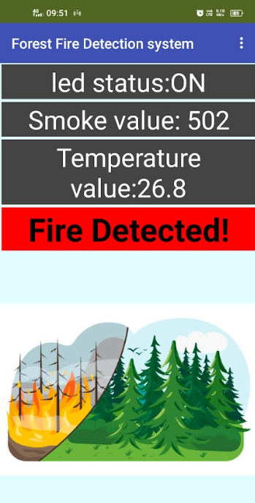
MIT INVENTOR APP

Slide 11
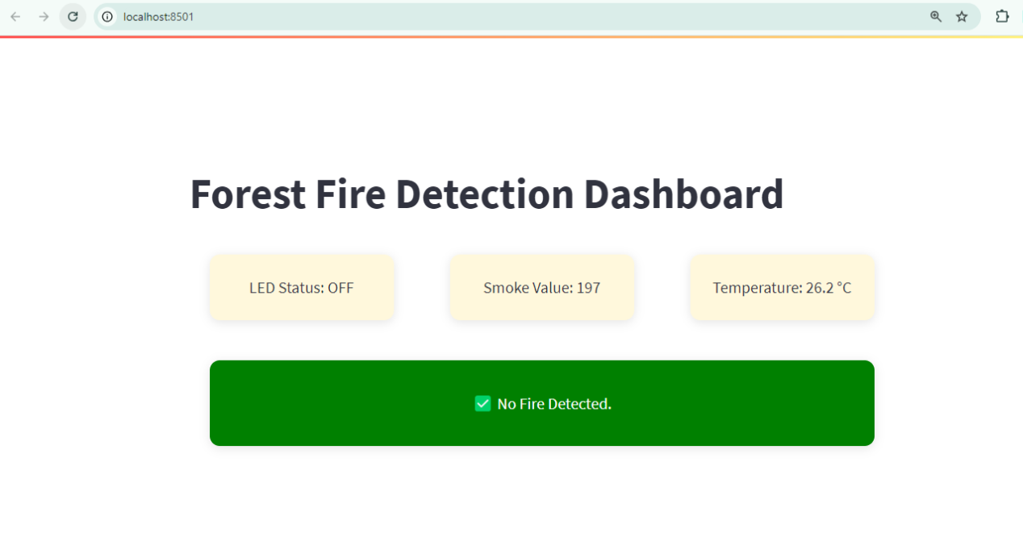
Streamlit WebApp

Slide 12
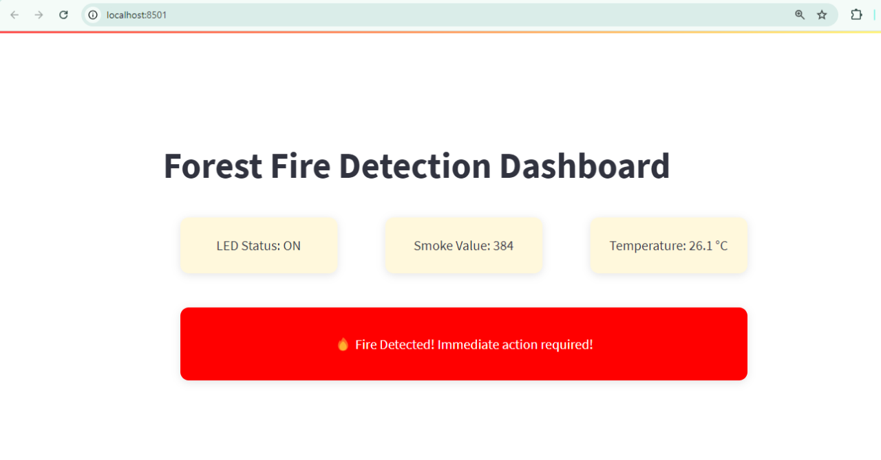
Streamlit WebApp

Slide 13
VIDEO LINK
https://drive.google.com/file/d/1y1fGOHQjUGsz1x90YkVus-LtZ8D5JWSN/view?usp=sharing

Slide 14
APPLICATIONS
Early Detection and Rapid Response: Automated forest fire detection systems, using sensor networks, provide early warnings of fire outbreaks. Early detection allows firefighting teams to respond quickly.
Wildlife Protection: Real-time fire detection allows for the evacuation and protection of wildlife in affected areas.
Air Quality Monitoring: Forest fires produce large amounts of smoke and particulates that can affect air quality for miles. Fire detection systems help authorities monitor and predict air quality deterioration, providing health alerts to communities, especially vulnerable populations like children and the elderly.

Slide 15
THANK YOU

